Slide 1
Who needs a ?
@kensipe
D2iQ
Notes:
Hey KUTTLers

Slide 2
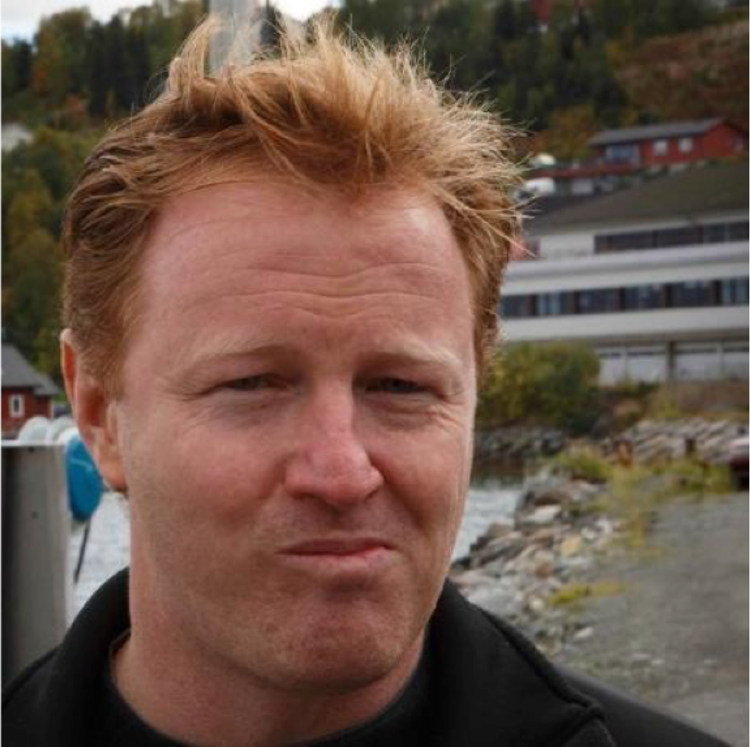

Ken Sipe
Distributed Application Engineer
And Orchestration Conductor
Apache Mesos, Kubernetes, KUDO, KUTTL
Developer: Embedded, C++, Java, Groovy, Grails, C#, Go
@KenSipe
ken@d2iq.com
2

Slide 3
What is KUTTL
KUbernetes Test TooL (kuttl)

Slide 4
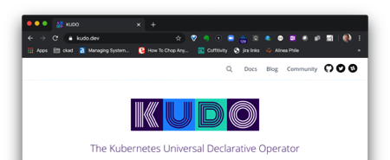
KUTTL Origins
Kubernetes Universal Declarative Operator
(KUDO)
Declarative Testing
Notes:
Justin

Slide 5
What is KUTTL
Unit
Integration
e2e
Notes:
Based on testing control plane

Slide 6
Who Needs a KUTTL?
Testing harness to declarative test:
operators
KUDO
helm charts
any other Kubernetes applications or controllers.

Slide 7
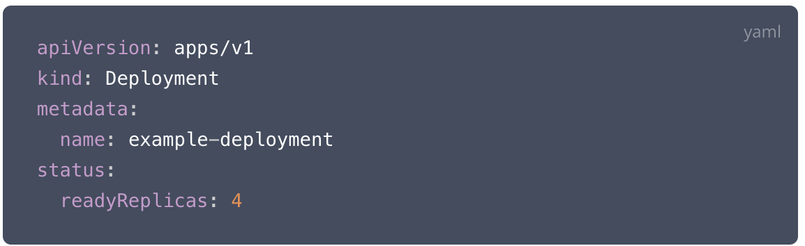
Who Needs a KUTTL?
write portable end-to-end, integration, and conformance tests for Kubernetes without needing to write any code
Assert:

Slide 8
KUTTL - New Use Cases
Setup and Verify
Testing in a specific namespace

Slide 9
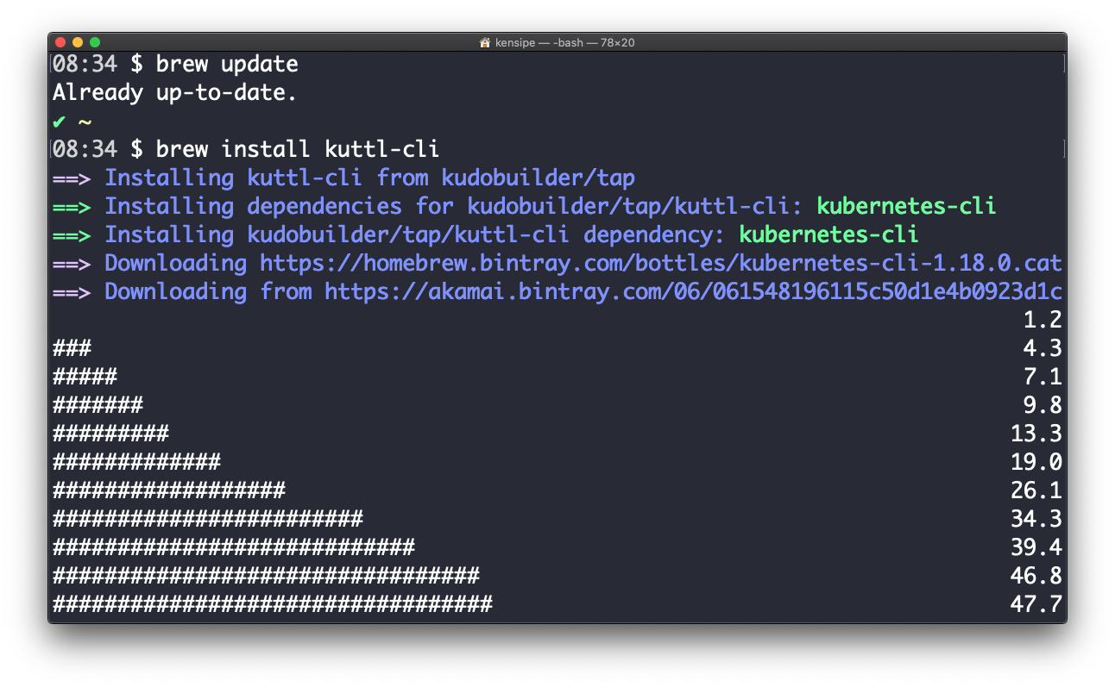
How Do I Start KUTTLing?
brew install kuttl-cli
kubectl krew install kuttl-cli*
API Integration
go get github.com/kudobuilder/kuttl

Slide 10
KUTTL Abstract
“Kuttling releases a cocktail of hormones in our brains including dopamine, serotonin and oxytocin. It can lower your blood pressure and heart rate.”
-- Wikipedia
Notes:
Who needs it?

Slide 11
The First KUTTLers
Justin Taylor-Barrick https://twitter.com/justinmbarrick
Gerred Dillon https://twitter.com/devgerred
Tom Runyon https://twitter.com/tommyrunyon
Zain Malik https://twitter.com/zMalikShxil
Special thanks to the rest of the KUDO team
Alena Varkockova https://twitter.com/alenkacz
Aleksey Dukhovniy https://kudo.dev/community/team/alex.html
Jan Schlicht https://kudo.dev/community/team/jan.html
Marcin Owsiany https://twitter.com/porridge80
Jeff McCormick https://github.com/jmccormick2001
Andreas Neumann
https://kudo.dev/community/team/

Slide 12
Agenda
Why Would you KUTTL?
Your first KUTTL
Ways to KUTTL
Where do you want to KUTTL?
Autonomy of a KUTTL
KUTTLing an Operator
KUTTL in Action
Future KUTTLing

Slide 13
Why Would you KUTTL?

Slide 14
KUTTL Origins
Kubernetes Universal Declarative Operator
(KUDO)
Declarative Testing
Notes:
Justin

Slide 15
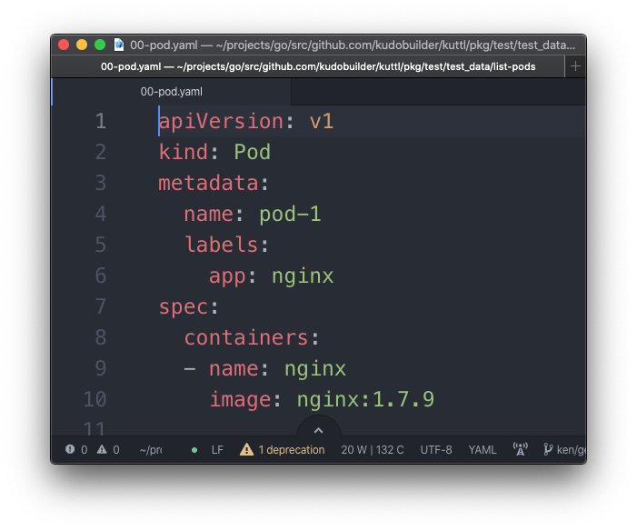
Declarative Testing
What does that mean?
Test Setup
Notes:
Justin

Slide 16
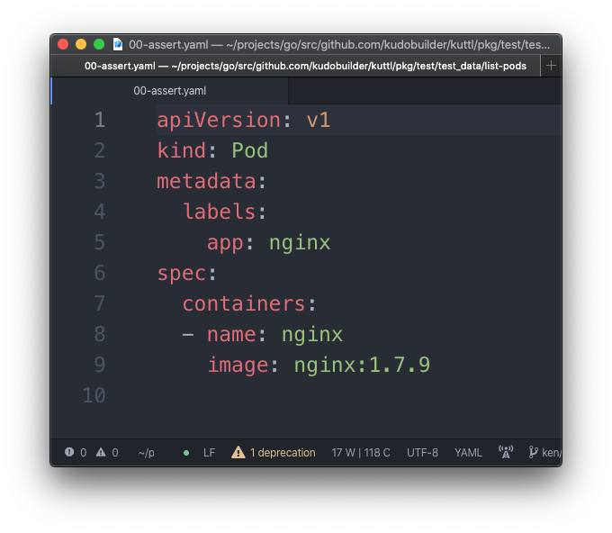
Declarative Testing
What does that mean?
Assert!
Notes:
Justin

Slide 17
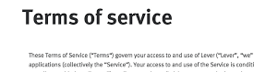
TestSuite
A collection of Tests
Test
A collection of TestSteps
TestStep
A “Step” in a Test
A Collection of declarative CRUD
Usually has an assert or error defined
TestAssert
Assert conditions

Slide 18
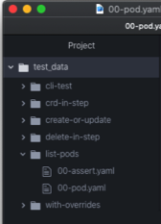
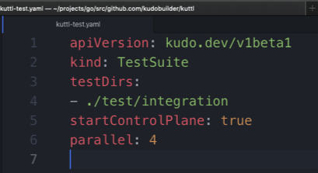
TestSuite
2 Concepts define a TestSuite
Folder of Tests
Configuration File

Slide 19
Test
A Collection of Test Steps
Test Name == Folder Name
“list-pods” is the name of this test

Slide 20
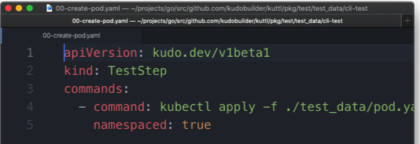
TestStep
2 Concepts define a TestStep
Indexed Files
Same Index, Same Step
Defined Kind

Slide 21
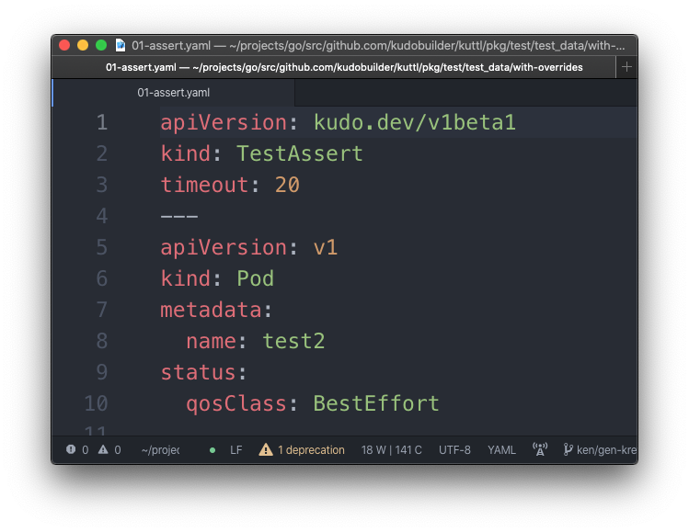
TestAssert
2 Concepts define a TestAssert
Step file named with ”assert” or “errors”
Defined Kind used within an assert step

Slide 22
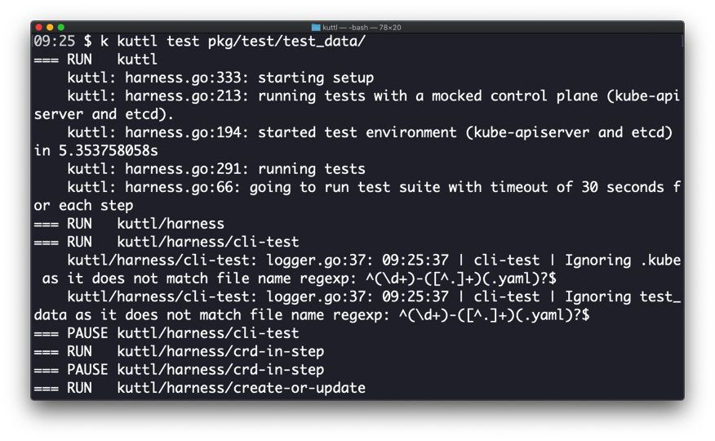
KUTTL a TestSuite

Slide 23
Your first KUTTL

Slide 24
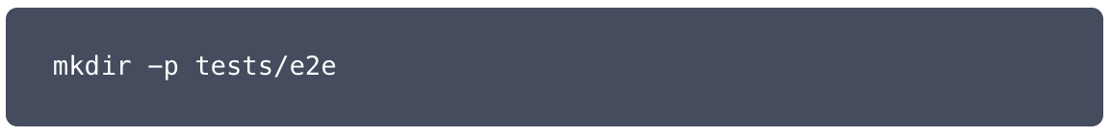
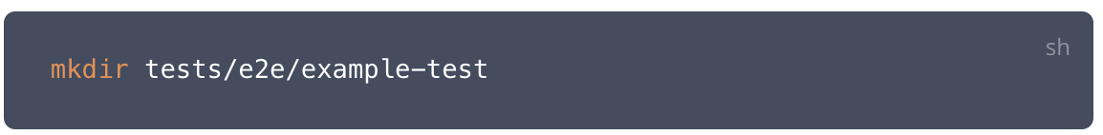
Test Case Setup

Slide 25
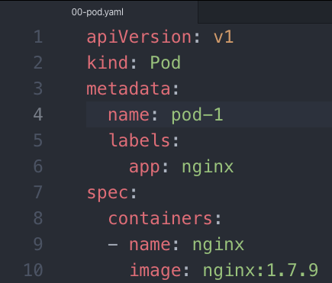
Test Step 00
Setup

Slide 26
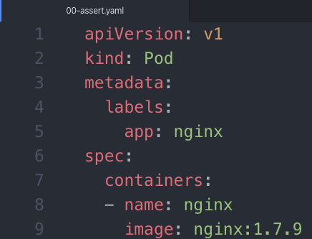
Test Step 00
Assert

Slide 27
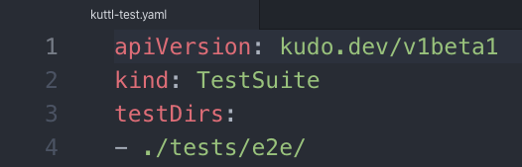
Test Suite Configuration
kuttl-test.yaml
Located in the working directory of kuttl

Slide 28
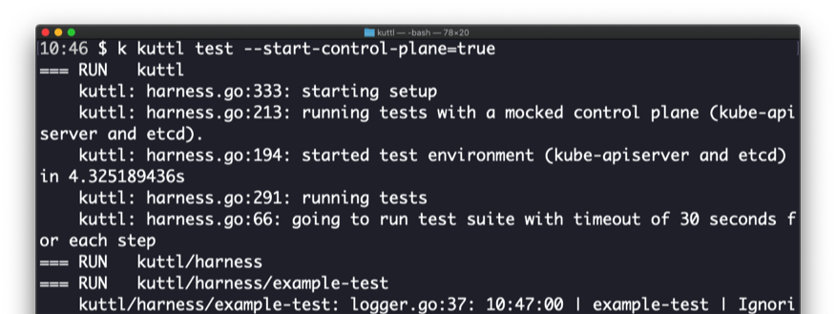
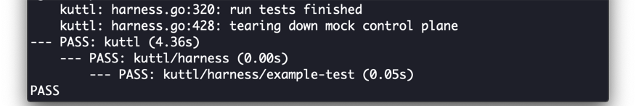
Run Test Suite

Slide 29
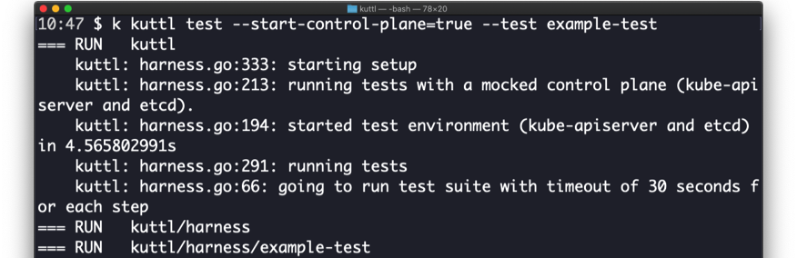
Running 1 Test From the Suite
--test <test-name>

Slide 30
Ways to KUTTL

Slide 31
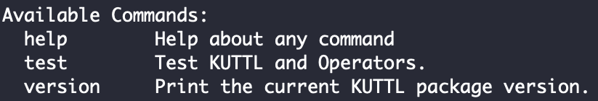
KUTTL CLI
k kuttl --help

Slide 32
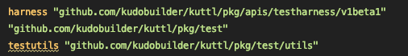

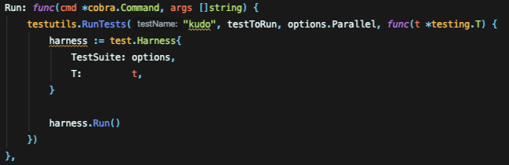
KUTTL Library Integration

Slide 33
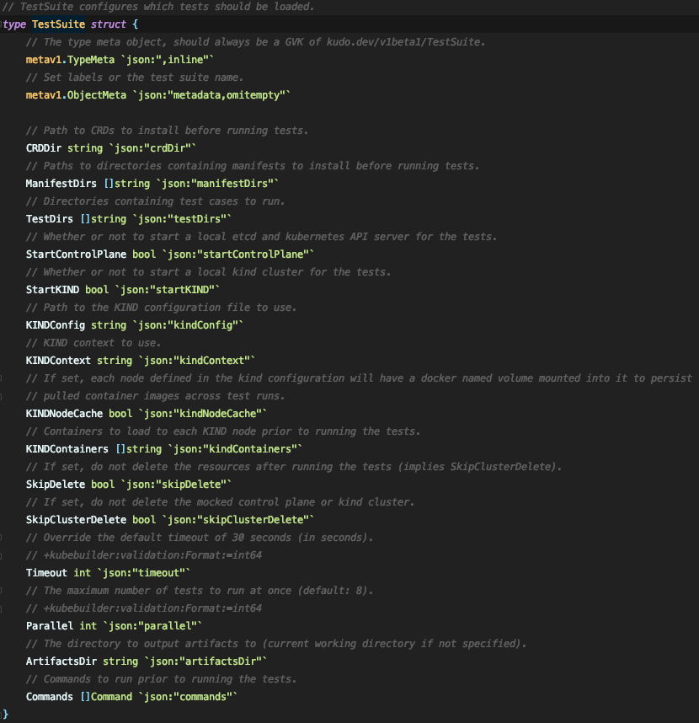
TestSuite Configuration

Slide 34
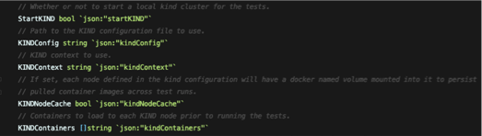
TestSuite Configuration
Kind Config

Slide 35
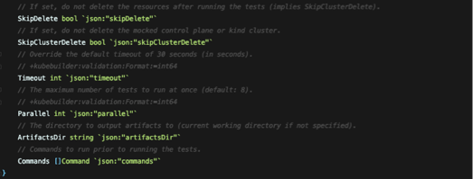
TestSuite Configuration

Slide 36
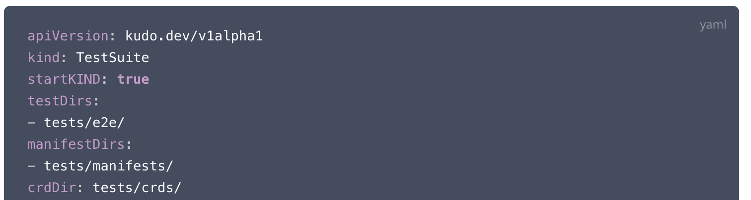
TestSuite Configuration
kuttl-test.yaml

Slide 37
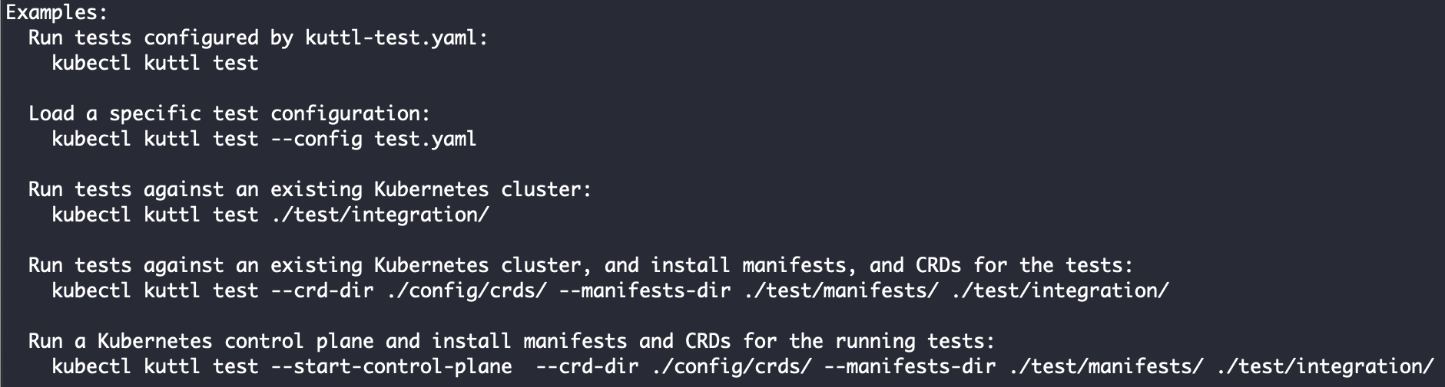
KUTTL CLI
Configuration or Override

Slide 38
Where do you want to KUTTL?

Slide 39
Where to KUTTL
Test Environments
Live Cluster
$KUBECONFIG or the --kubeconfig flag
Kind
`startKIND: true` in kuttl-test.yaml or --start-kind=true
Lots of kind control
Mocked Control Plane
`startControlPlane: true` in kuttl-test.yaml or --start-control-plane
Notes:
Live Cluster – large cluster or special (gpu etc)
Kind cluster – local cluster
Control Plane – simple

Slide 40
Kind Cluster
Special Kind Configuration
kubectl kuttl test --kind-config=kind.yaml
Setting Kind Context
kubectl kuttl test --kind-context=foo
Preload Container Images
* In kuttl-test.yaml kindContainers:
Keep Cluster for analysis
kubectl kuttl test --skip-cluster-delete

Slide 41
Autonomy of a KUTTL

Slide 42
Test Steps
Files and Format
Test files: *.yaml or *.yml
Other files ignored
useful for docs, license, etc.
<index>-<step-name>.yaml
tests/e2e/example/00-pod.yaml
tests/e2e/example/00-example.yaml
tests/e2e/example/01-staging.yaml
Step is all indexed files, evaluated followed by asserts (more to come)
Multiple YAML docs is common in a file

Slide 43
Test Steps
Create or Update
Step files are:
Created if they do not exist in cluster
Patch Updated if they exist
Possible to express minimum updates
Delete is possible through a TestStep Object

Slide 44
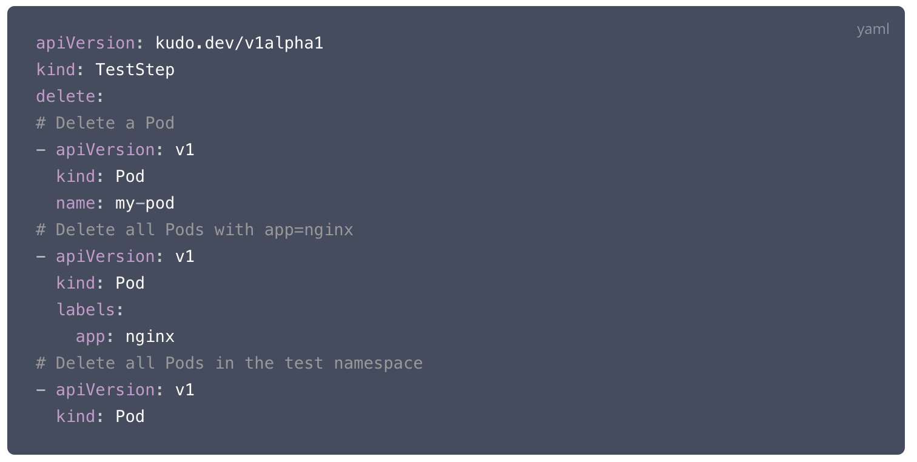
Test Steps
Delete
Delete is possible through a TestStep Object:

Slide 45
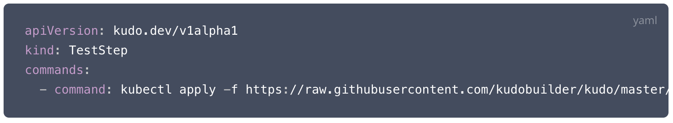
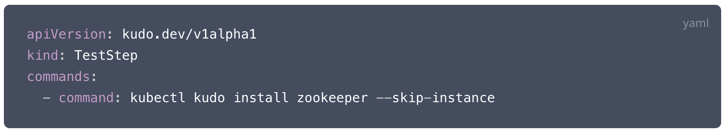
Test Steps
commands
Arbitrary commands are possible and are run at the beginning of the step and run until complete
Notes:
Fail of command is a test failure (unless ignored)

Slide 46
Asserts and Errors
Format
<index>-assert.yaml
Asserts the state was met within a time limit (default: 30 secs)
<index>-errors.yaml
Asserts if a state exists that it is an error
Asserts the absence of an object

Slide 47
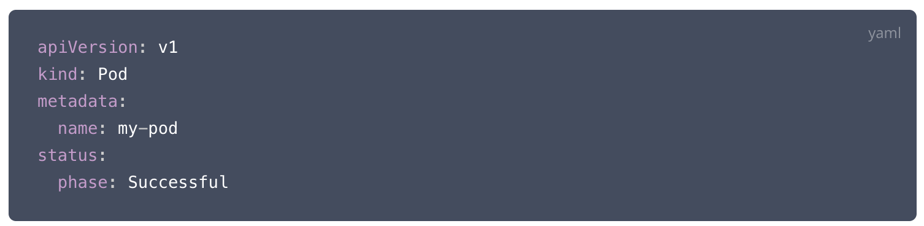
Asserts and Errors
Example
For Assert:
Passes if there is a pod
named my-pod
status.phase=Successful
No other fields are evaluated
Notes:
Remove `name: my-pod` and it asserts that any pod with a status phase of success is true
If in <index>errors.yaml, then it fails if it exists

Slide 48
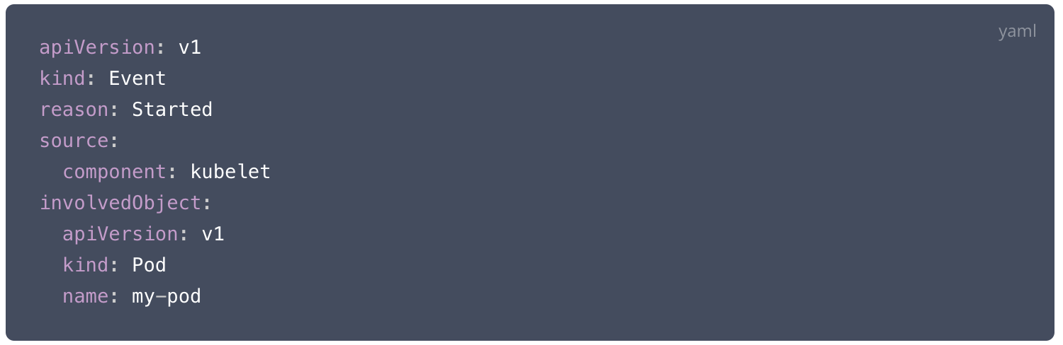
KUTTLing Tips
Kuberenetes Events are Objects
Asserts that an Event with reason “Started” happened for `my-pod`

Slide 49
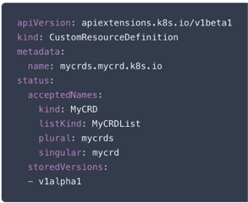
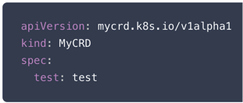
KUTTLing Tips
CRDs or Waiting for K8S
Certain objects (like CRDs) take time before they are available resources.
At the TestSuite level, defined CRDs are waited for prior to tests
IF you have a CRD as part of a step, it is necessary to assert for that CRD prior to using.
Assuming 00-crd.yaml
00-assert.yaml
01-use.yaml
https://kudo.dev/docs/testing/tips.html#custom-resource-definitions

Slide 50
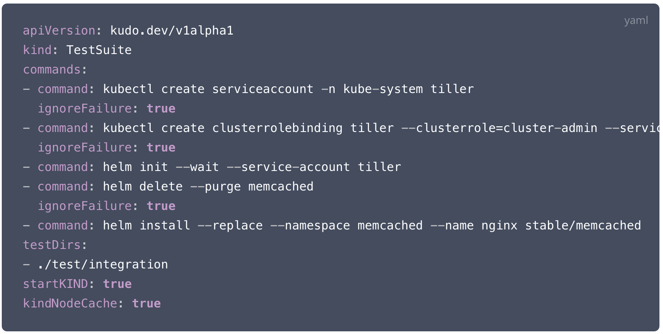
KUTTLing Tips
Helm
Also possible in a TestStep

Slide 51
KUTTLing an Operator

Slide 52
Operators
CRD
Installing CRDs
crdDir in kuttl-test.yaml
Or
k kuttl test --crd-dir
Loads and Waits for CRD

Slide 53
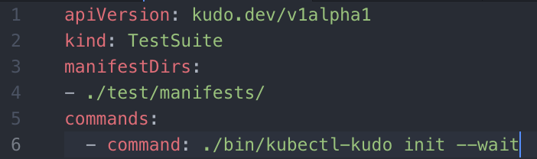
Operators
Controller
Examples for KUDO
KUDO controller (named manager) can be installed from the kudo cli
* k kudo init --wait
Notes:
Wait provides the confirmation of ready
Only good for released controllers

Slide 54
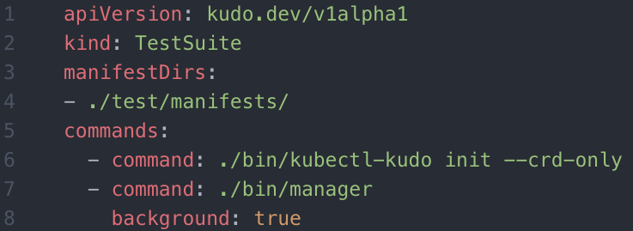
Operators
Controller in Dev
Examples for KUDO
After a `make manager` makefile task, run the `bin/manager` and set the `background` to true.
Notes:
New and previously missing feature to allow any controller
Needs a readiness probe!

Slide 55
KUTTL in Action

Slide 56
Future KUTTLing

Slide 57
KUTTL Released
KUTTL v0.1.0
Released March 26, 2020
However it was based on 1 year of KUDO development
KUTTL v0.6.1
Released Aug 25, 2020
We are releasing about once per month

Slide 58
Call to Action
Get Involved
KUTTL Project
https://github.com/kudobuilder/kuttl
k8s.io slack #kudo
https://app.slack.com/client/T09NY5SBT/CG3HTFCMV
Current docs:
https://kudo.dev/docs/testing.html
Expect http://kuttl.dev shortly
KEP Process
https://github.com/kudobuilder/kuttl/blob/master/keps/0001-kep-process.md

Slide 59
Thank you for KUTTLing with me! KUTTL https://github.com/kudobuilder/kuttl
ken@D2iQ.com @kensipe

